Slide 1
Lesson 2 Erie Canal In Action

Slide 2
Remembering what we learned last class☺
You have your Who What When Where and How About the Erie Canal Worksheet.
Can anyone share some facts you learned last class?

Slide 3
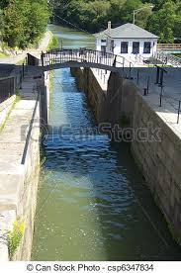
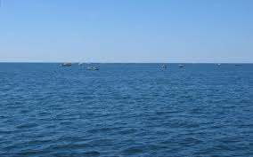
Page: 1
Look at the water in these two pictures what is the difference (size)?

Slide 4
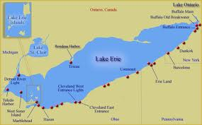
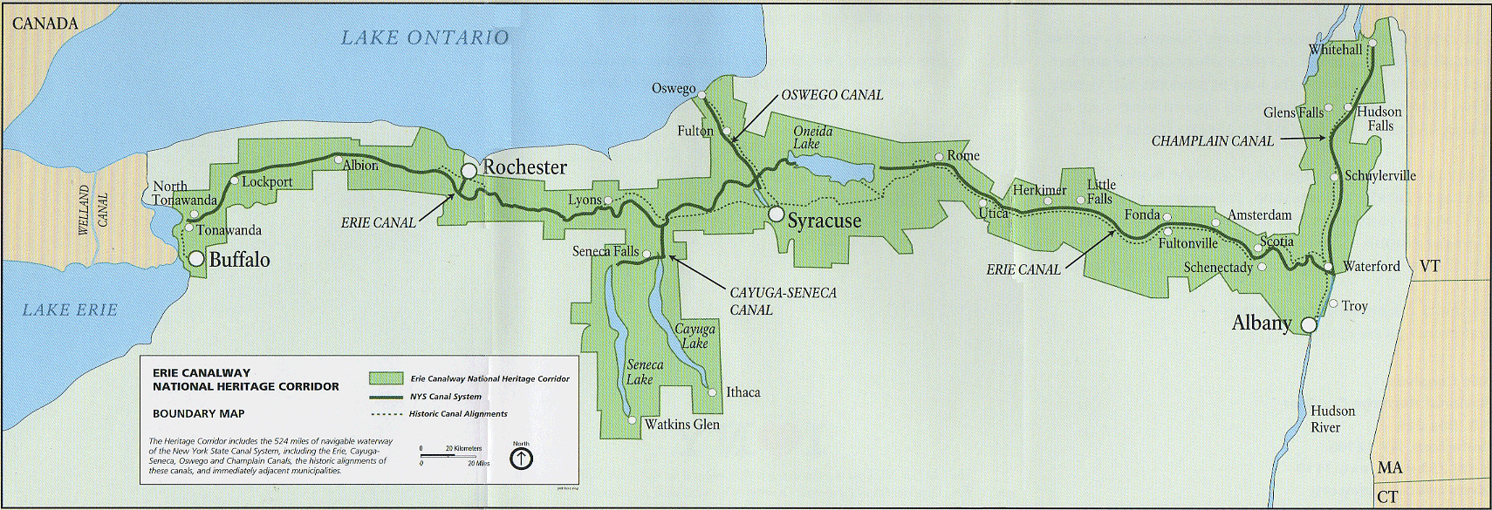
Lets look at the map Which is bigger? Which is longer?
Page:2

Slide 5
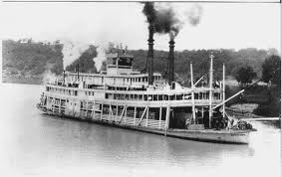
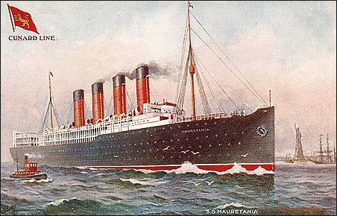
Which boat would you chose to fit which size of water?
Page:3

Slide 6
How it works with real pictures
Page:4
1. Farmers: Grain From the Midwest
3. Store Grain in Grain Elevator
2. Big Ships on the Lake Erie
4.Load Grain on small ships to the Erie Canal
5. Give grain to merchants to sell to stores

Slide 7
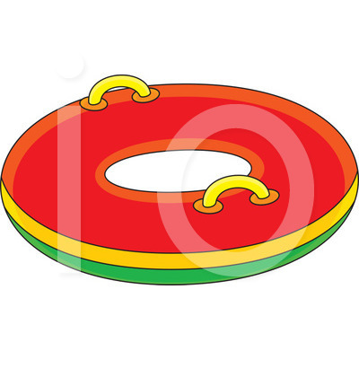
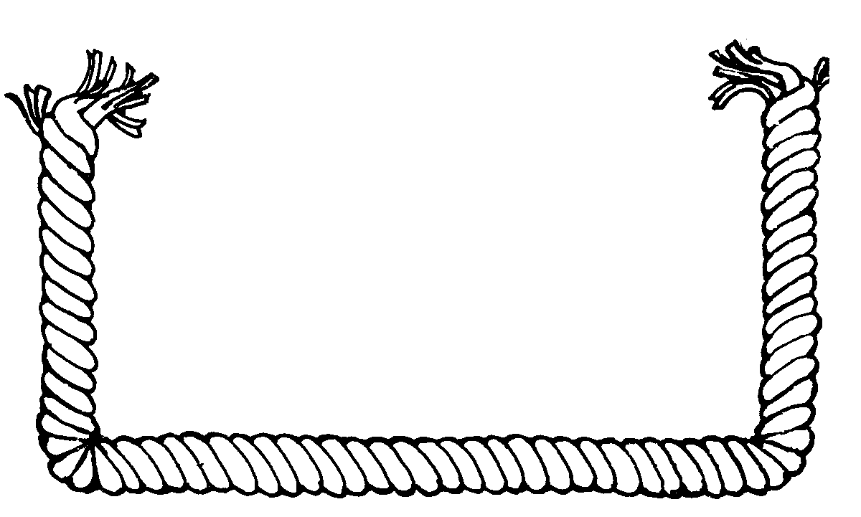
Page:5
Little Inner Tube
Big Inner Tube
Rope
Desk
1 Big Inner Tube(1 Big ship)=
3Little Inner Tubes(3 Small ships)
1 Big Inner Tube can carry 1 basket with 6 books
1 Small Inner Tube can carry 1 basket with 2 books
Basket of Books
Notes:
One big inner tub will be equal to three little inner tubes

Slide 8
Page: 6
You will take a piece a paper from the bowl and that will be your role in this activity

Slide 9
Roles & What You Do: (1$Per Book)
Farmers:
* Already made the books
* packing books into the basket
Big Boat Captain (use big inner tubes):
* Carry a basket of 6 books
Give money to Farmers
Small Boat Captain (use small inner tubes):
Carry 2 books each to the merchants
Merchants:
Give money to the small boat captains
Take the books
Workers at the mill
In charge of tying the rope to the basket pull it up
transfer books to the Small Boat Captain
Accountant:
Count how many books and big boats came in
how many books and small boats went out.
Give money to the big boat captain for there books
Take money from Little boat captains
Page:7

Slide 10
End of Lesson Reflection Worksheet
Please write one sentence for questions 2 and 3
Questions:
1. What is your role in this activity?
2. What did you do?
3. And how does it relate to how the Erie Canal works?

Slide 11
References
http://www.clipartbest.com/cliparts/nTX/zLG/nTXzLGqTB.gif
http://hippocampus.files.wordpress.com/2012/02/booksinbasket.jpg
http://www.clker.com/cliparts/7/B/m/t/z/g/desk-hi.png
http://thumbs.dreamstime.com/z/inner-tube-15096116.jpg
http://www.illustrationsof.com/royalty-free-inner-tube-clipart-illustration-1226779.jpg
http://www.canstockphoto.com/erie-canal-locks-lockport-new-york-6347834.html
https://encrypted-tbn3.gstatic.com/images?q=tbn:ANd9GcQmhkc1QkU_EbB57d2tjIPTpvxZVSxuRszrRD3exqtXf_encFYU
http://www.doukhobor.org/SSMauretania.jpg
https://encrypted-tbn2.gstatic.com/images?q=tbn:ANd9GcQgcvfpYOQlQA47F-l0q3pb-CRelguaS01JbCb4VBH63WKfDbrm
Ejg0dOKY14/s1600/Erie+Canal+buffalo+NY+fm+eriecanal.org.jpghttp://www.latinamericanstudies.org/united-states/Erie-canal-map.gif

