Slide 1
Sing and Explore The Erie Canal!
Lesson 3

Slide 2
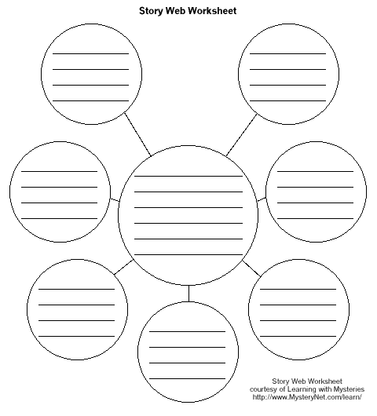
Directions: Use this web page to answer questions I ask during the lesson. Please write each answers not in the center of the web until I tell you to do so.

Slide 3
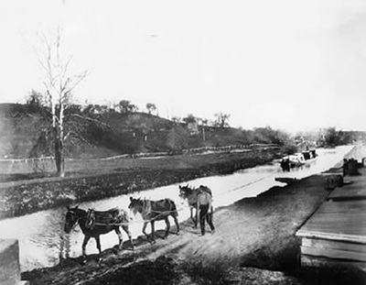
Before the invention of steamships or railways they used horses to pull the boat.
Page:1

Slide 4
Time Line
Page:2
1st →Haled by horses and mules
2nd →Steam (Around the time of 1905)
3rd →Diesel or Gasoline (this is what we use now)
Question#1: How did the boat move before diesel or Gasoline was used as fuel?

Slide 5
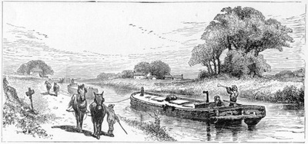
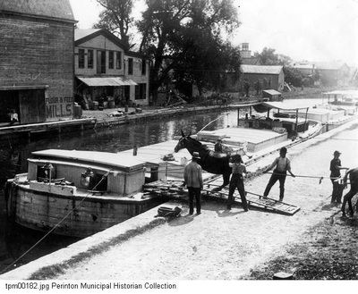
I will pass out a different pictures I found for all of you to look at.
Page:3

Slide 6
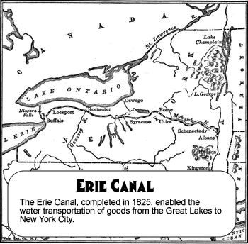
The Erie Canal is a Canal in New York that originally ran about 363 miles from Albany, New York, on the Hudson River to Buffalo, New York, at Lake Erie. It opened on October 26, 1825
Page:4
Show Map
Question#2: How long was the original Erie Canal and which city did the canal start and which city did the canal end up?

Slide 7
Why do you think boat was better then a buggy(horse wagon)?
Page:5
It is lighter and faster to carry heavy things on water because the water keeps goods floating.
This way you can carry more goods at once.
If you carry things on land there is no water to help hold up some of the weight. Therefore, it is heavier and you will have to carry less.
Which means you will earn less money…… remember last class you were only paid for the amount of books you carried?
Question#3: Why use the water to transport things?

Slide 8
Lets first listen to the song and read the lyrics while we listen The Low Bridge Song By: Thomas S. Allen (1876-1919)
Page:6
https://www.youtube.com/watch?v=vQE2sNfYXpg
https://www.youtube.com/watch?v=O32NDyqkctg
Question#4: (Please put answers to all three questions in the middle of the web)
What is the title of the song?
Who wrote the song?
When was the song written?

Slide 9
Each students will receive a lyrics sheet http://www.eriecanalsong.com/ Now Lets Read The Lyrics !
Page:7
I've got an old mule and her name is Sal Fifteen years on the Erie Canal She's a good old worker and a good old pal Fifteen years on the Erie Canal We've hauled some barges in our day Filled with lumber, coal, and hay And every inch of the way we know From Albany to Buffalo
Question#5: What are Barges? What are they filled with?

Slide 10
Chorus:
Page: 8
Low bridge, everybody down
Low bridge for we're coming to a town
And you'll always know your neighbor
And you'll always know your pal
If you've ever navigated on the Erie Canal
We'd better look 'round for a job old gal Fifteen miles on the Erie Canal 'Cause you bet your life I'd never part with Sal Fifteen miles on the Erie Canal Git up there mule, here comes a lock
Explain to students:
mules would rest while waiting for barges to go through the lock We'll make Rome 'bout six o'clock One more trip and back we'll go Right back home to Buffalo
Question#6: Why is the song called Low Bridge?
HINT: What happened in the cartoon music video when the boat had to go under a bridge?
Question#7: What does the mules do when there was a lock to pass?

Slide 11
Chorus
Page:9
Oh, where would I be if I lost my pal? Fifteen miles on the Erie Canal Oh, I'd like to see a mule as good as Sal Fifteen miles on the Erie Canal A friend of mine once got her sore Now he's got a busted jaw, 'Cause she let fly with her iron toe, And kicked him in to Buffalo.

Slide 12
Chorus
Page: 10
Don't have to call when I want my Sal Fifteen miles on the Erie Canal She trots from her stall like a good old gal Fifteen miles on the Erie Canal I eat my meals with Sal each day I eat beef and she eats hay And she ain't so slow if you want to know She put the "Buff" in Buffalo
Question#8: The old canal we learned was 363 miles long so why does he sing 15 miles?
Hint: How long can “Sal” the mule travel before she needs to rest?

Slide 13
Page: 11
Now let’s sing the song one time before end of class

Slide 14
All resources used are on resource page on my website
Page: 12

